Slide 1
Cyclistic: Comparing member and casual riders
Prepared by: Derek Mitchell Version: January 25, 2023

Slide 2
What’s Ahead
Objectives
Findings
Recommendations
Thoughts and Questions

Slide 3
Objective
Our objective was to analyze Cyclistic data from 2022 to see how our annual members and casual users differ in their uses of Cyclistic bikes.
In order to achieve this objective, we looked at the following areas in the data:
Total Rides
Most popular day of the week of use
Length of rides
Mode of transportation

Slide 4
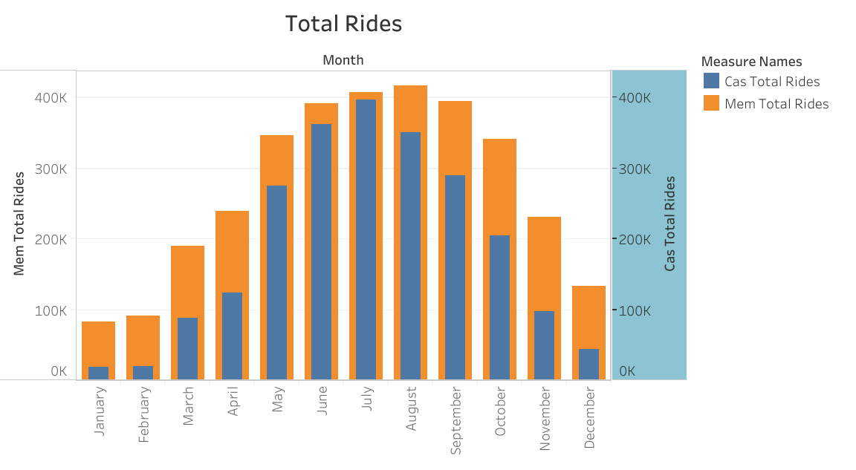
Total Rides
Overall, Member users take more trips overall than our casual users
Both types of users follow a similar use pattern. Peak ride usage is in July, with the least amount of riders in January

Slide 5
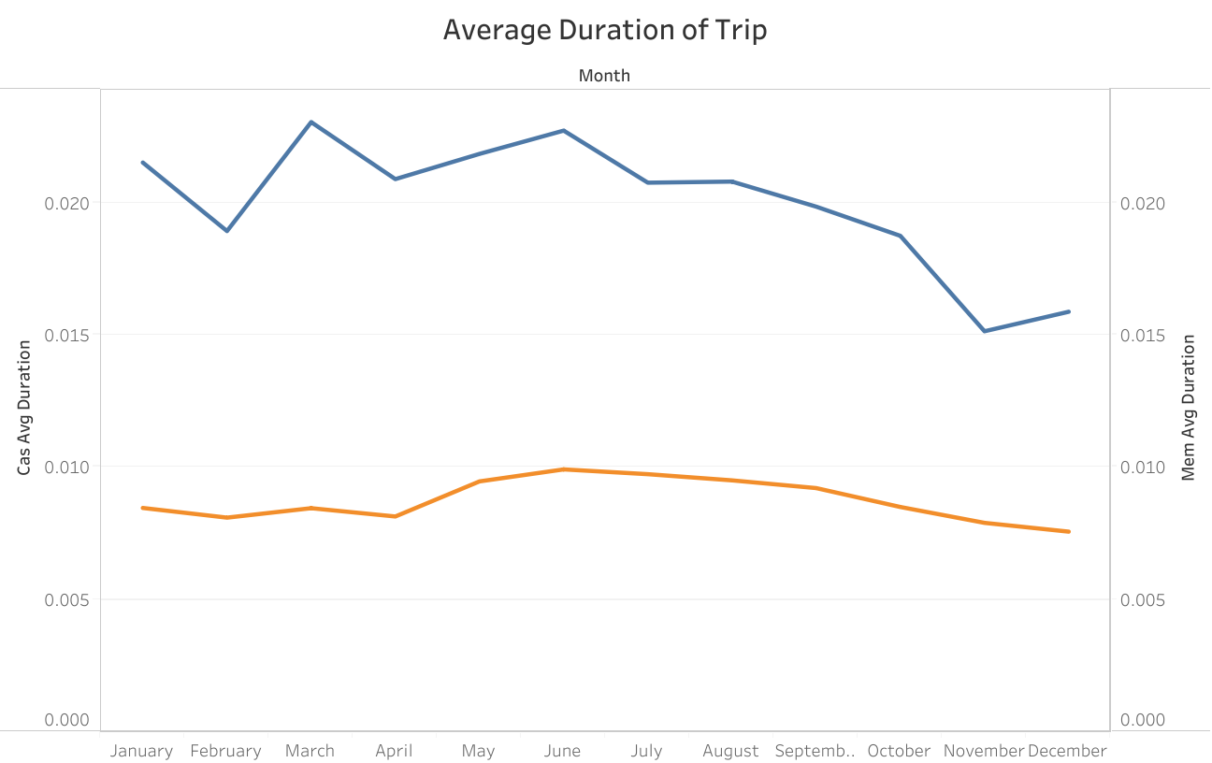
Trip Duration
Casual users have a large average trip duration than Member users over all months by a significant margin

Slide 6
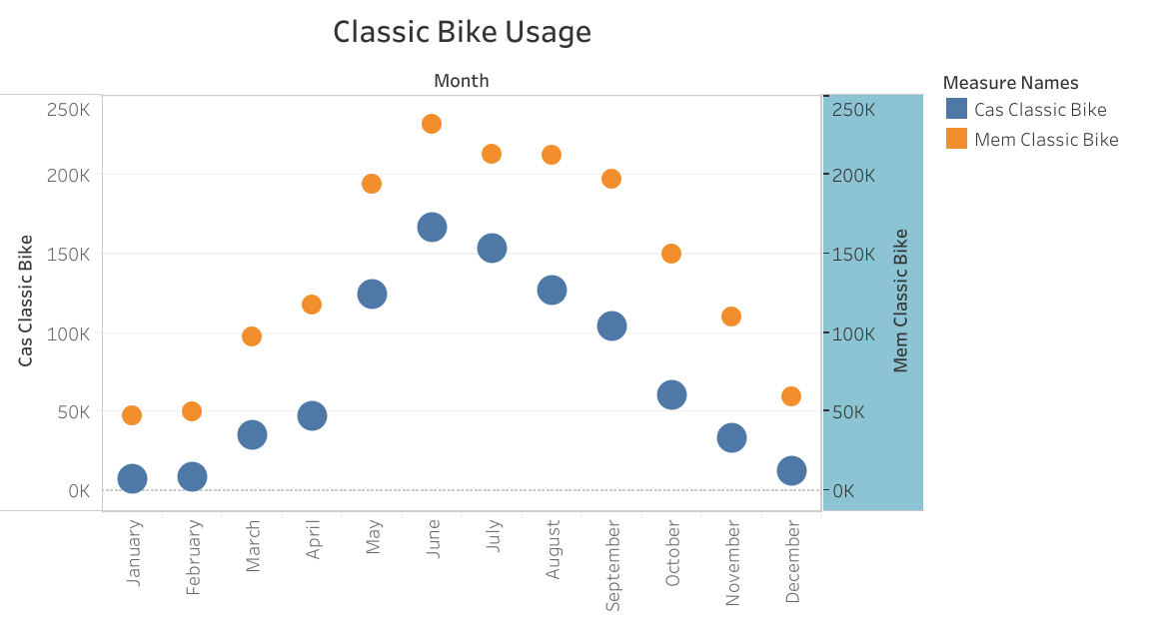
Classic Bikes
Members use classic bikes more often than casual users

Slide 7
Docked Bikes
Casual members are the only group that use the docked bike offering

Slide 8
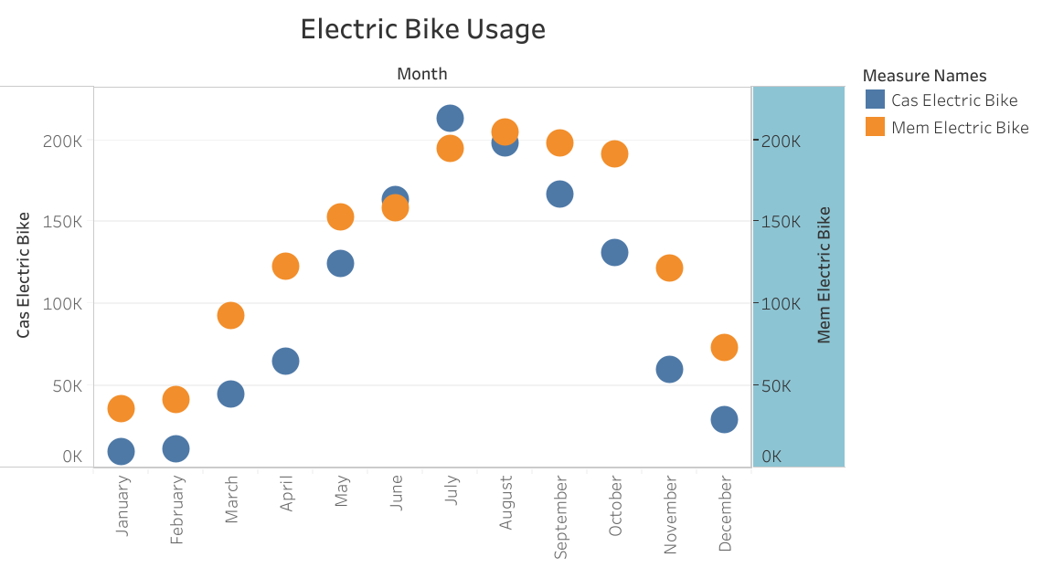
Electric Bikes
On average, our Members tend to use the electric bike offering more than our Casual users. However, during the summer months, Casual users eclipse the usage of Members.

Slide 9
Recommendations
Showcase the cost efficiency of becoming a member to casual riders, as they may be spending more to take longer rides by utilizing single rides at a singular price point, whereas if they become members, they could save money and still enjoy the same number and length of rides.
Offer casual users a reduced cost start up membership in the Spring, they can use the services at a lesser cost, at a more optimal time of the year for better weather and entice them to continue using the services on a more regular basis.
Move away from the availability of docked bikes, as both users use other modes far more often and member users don’t use them at all.

Slide 10
Thoughts and Questions?
Thank you for your time!

Slide 11
Data source
Courtesy of Motive International Inc. https://divvy-tripdata.s3.amazonaws.com/index.html

